Slide 1
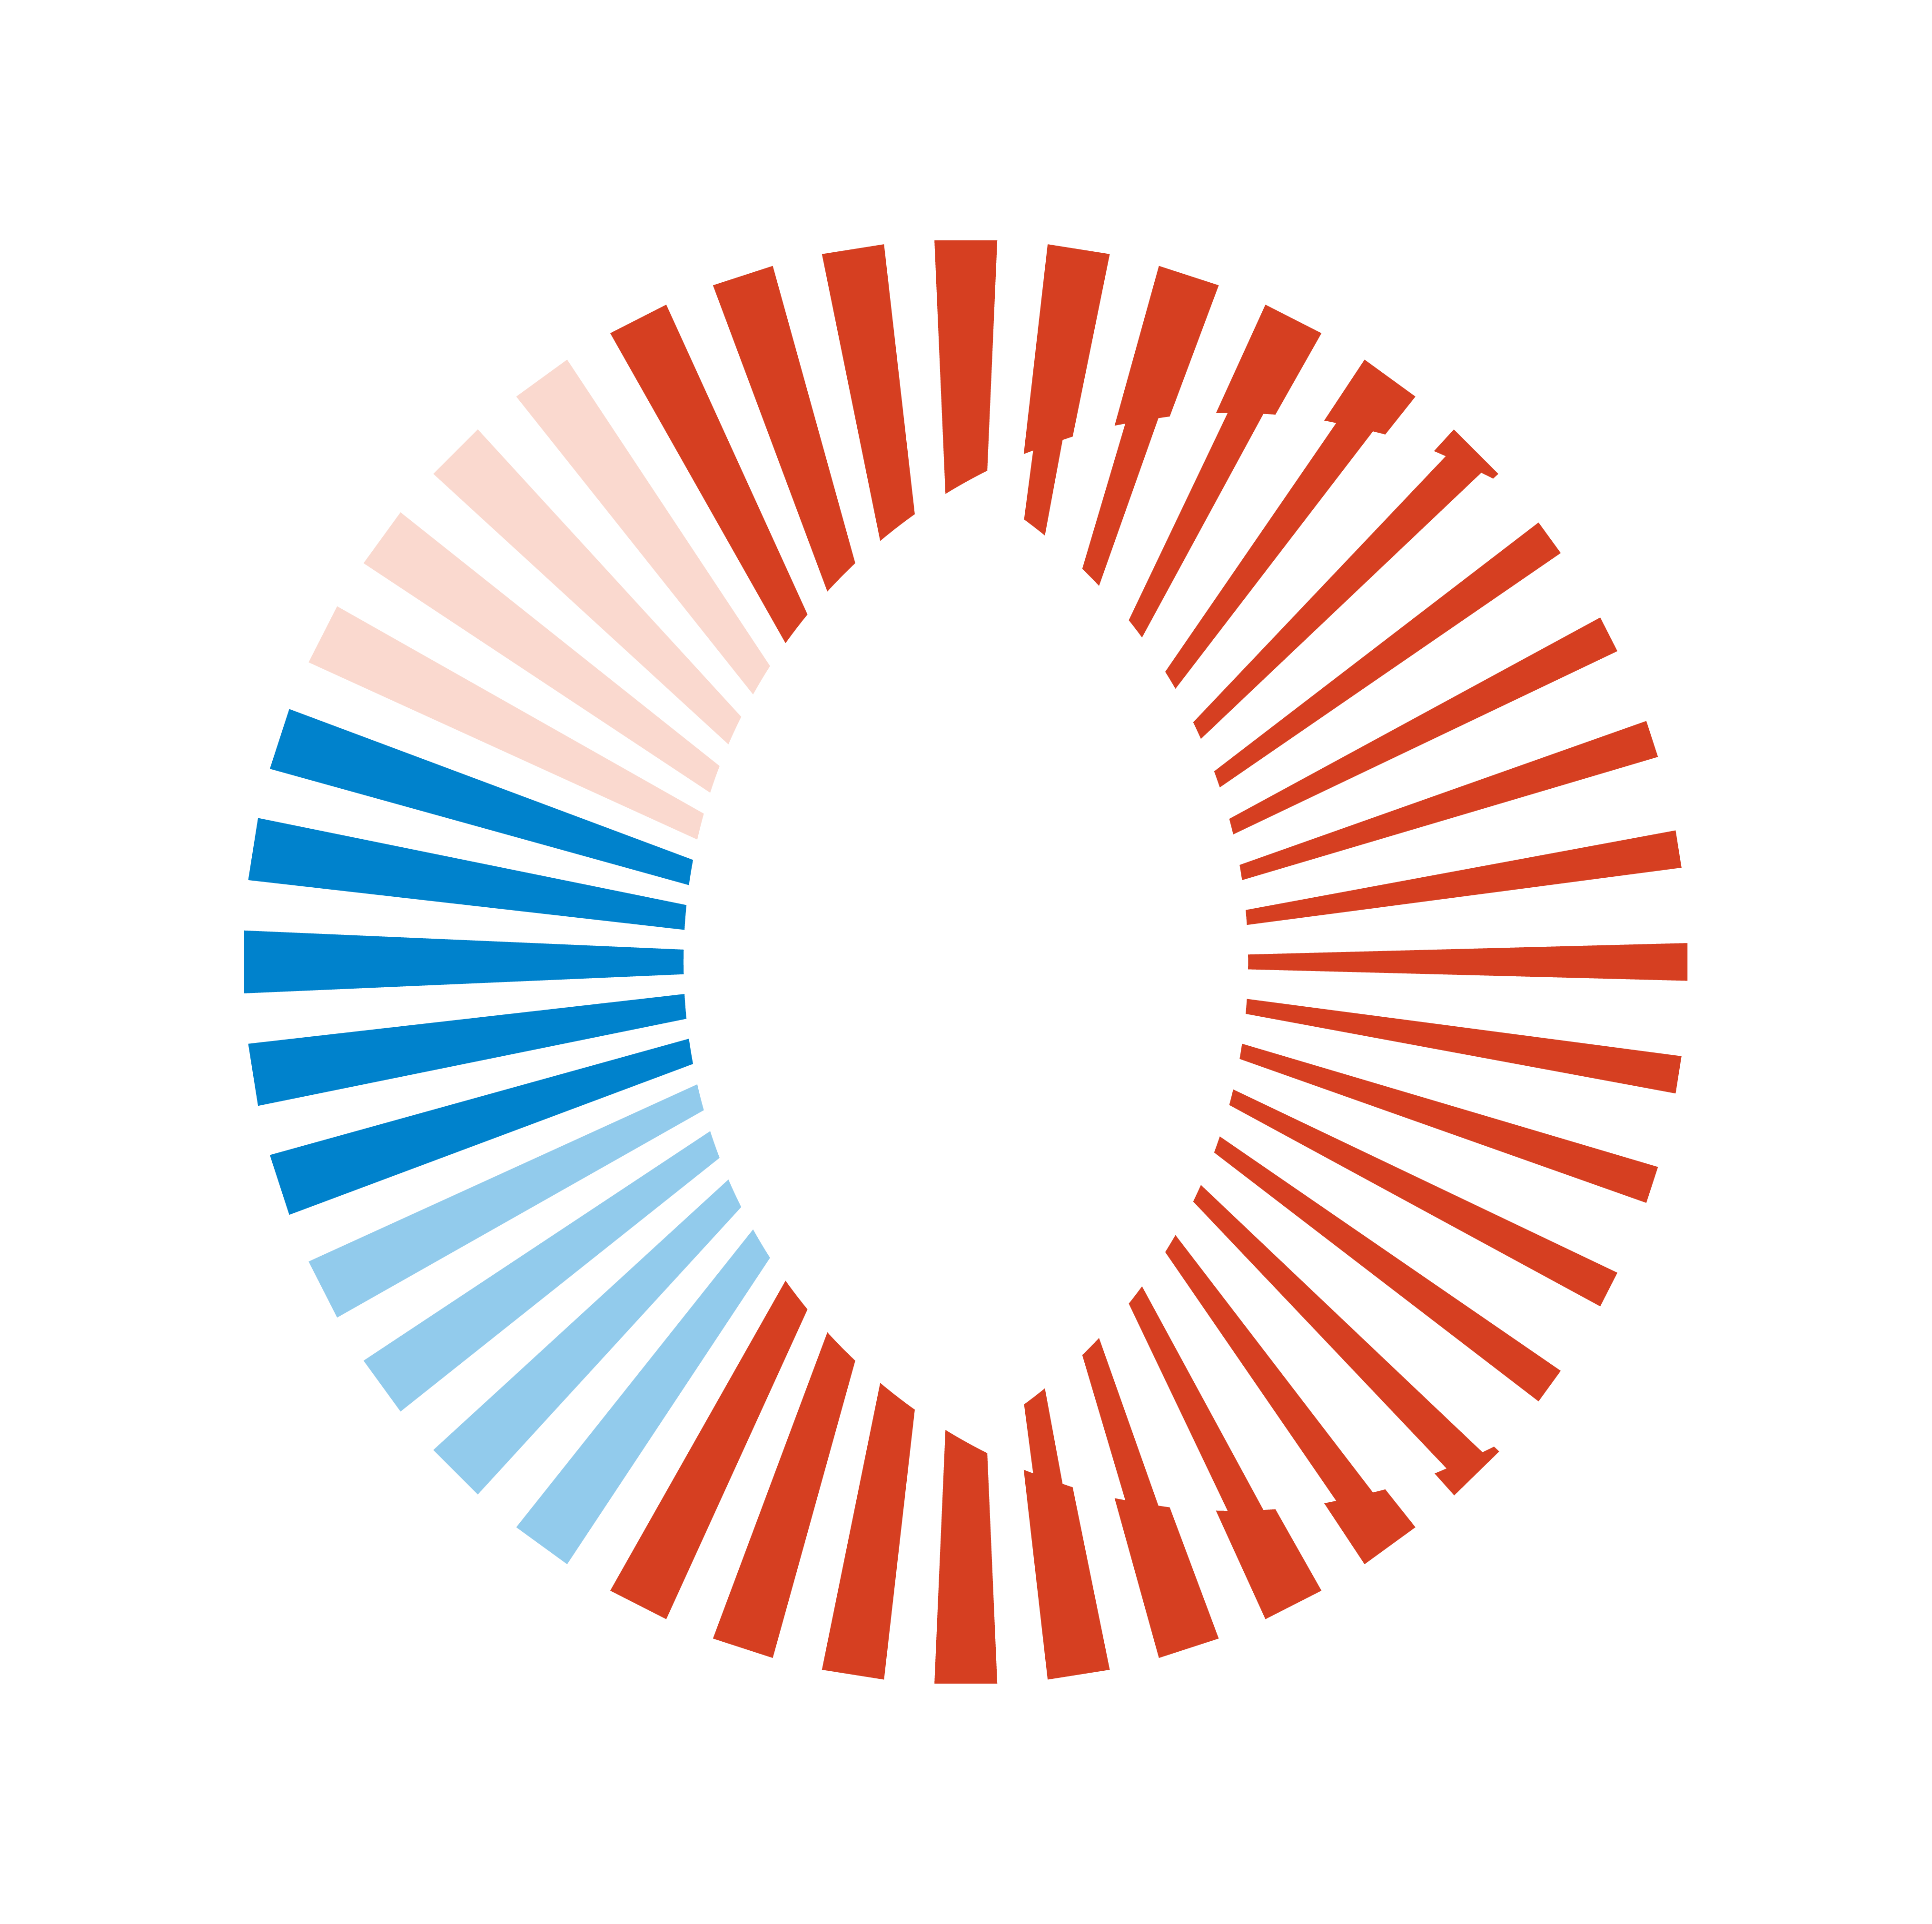
Creating a high-performance environment for major gifts
April 16, 2023

Slide 2
AGENDA FOR TODAY
Overview of National Philanthropy Trends in Giving USA Data
What Works – Trends and Lessons Learned in Major Giving
Building and Retaining Your Major Gifts Team
Maximizing Your Fundraising ROI with a High-Performance Team and Plan

Slide 3
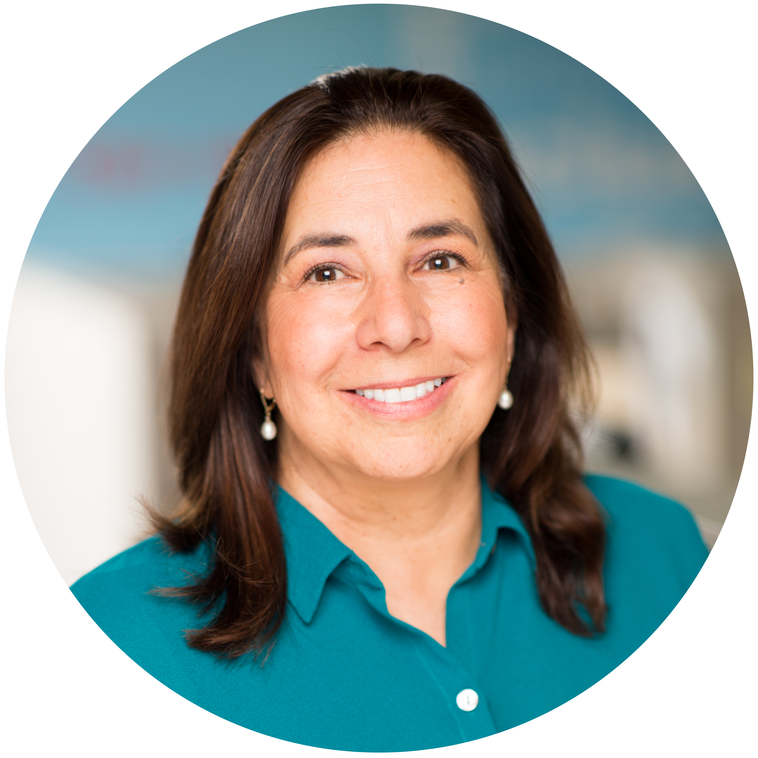
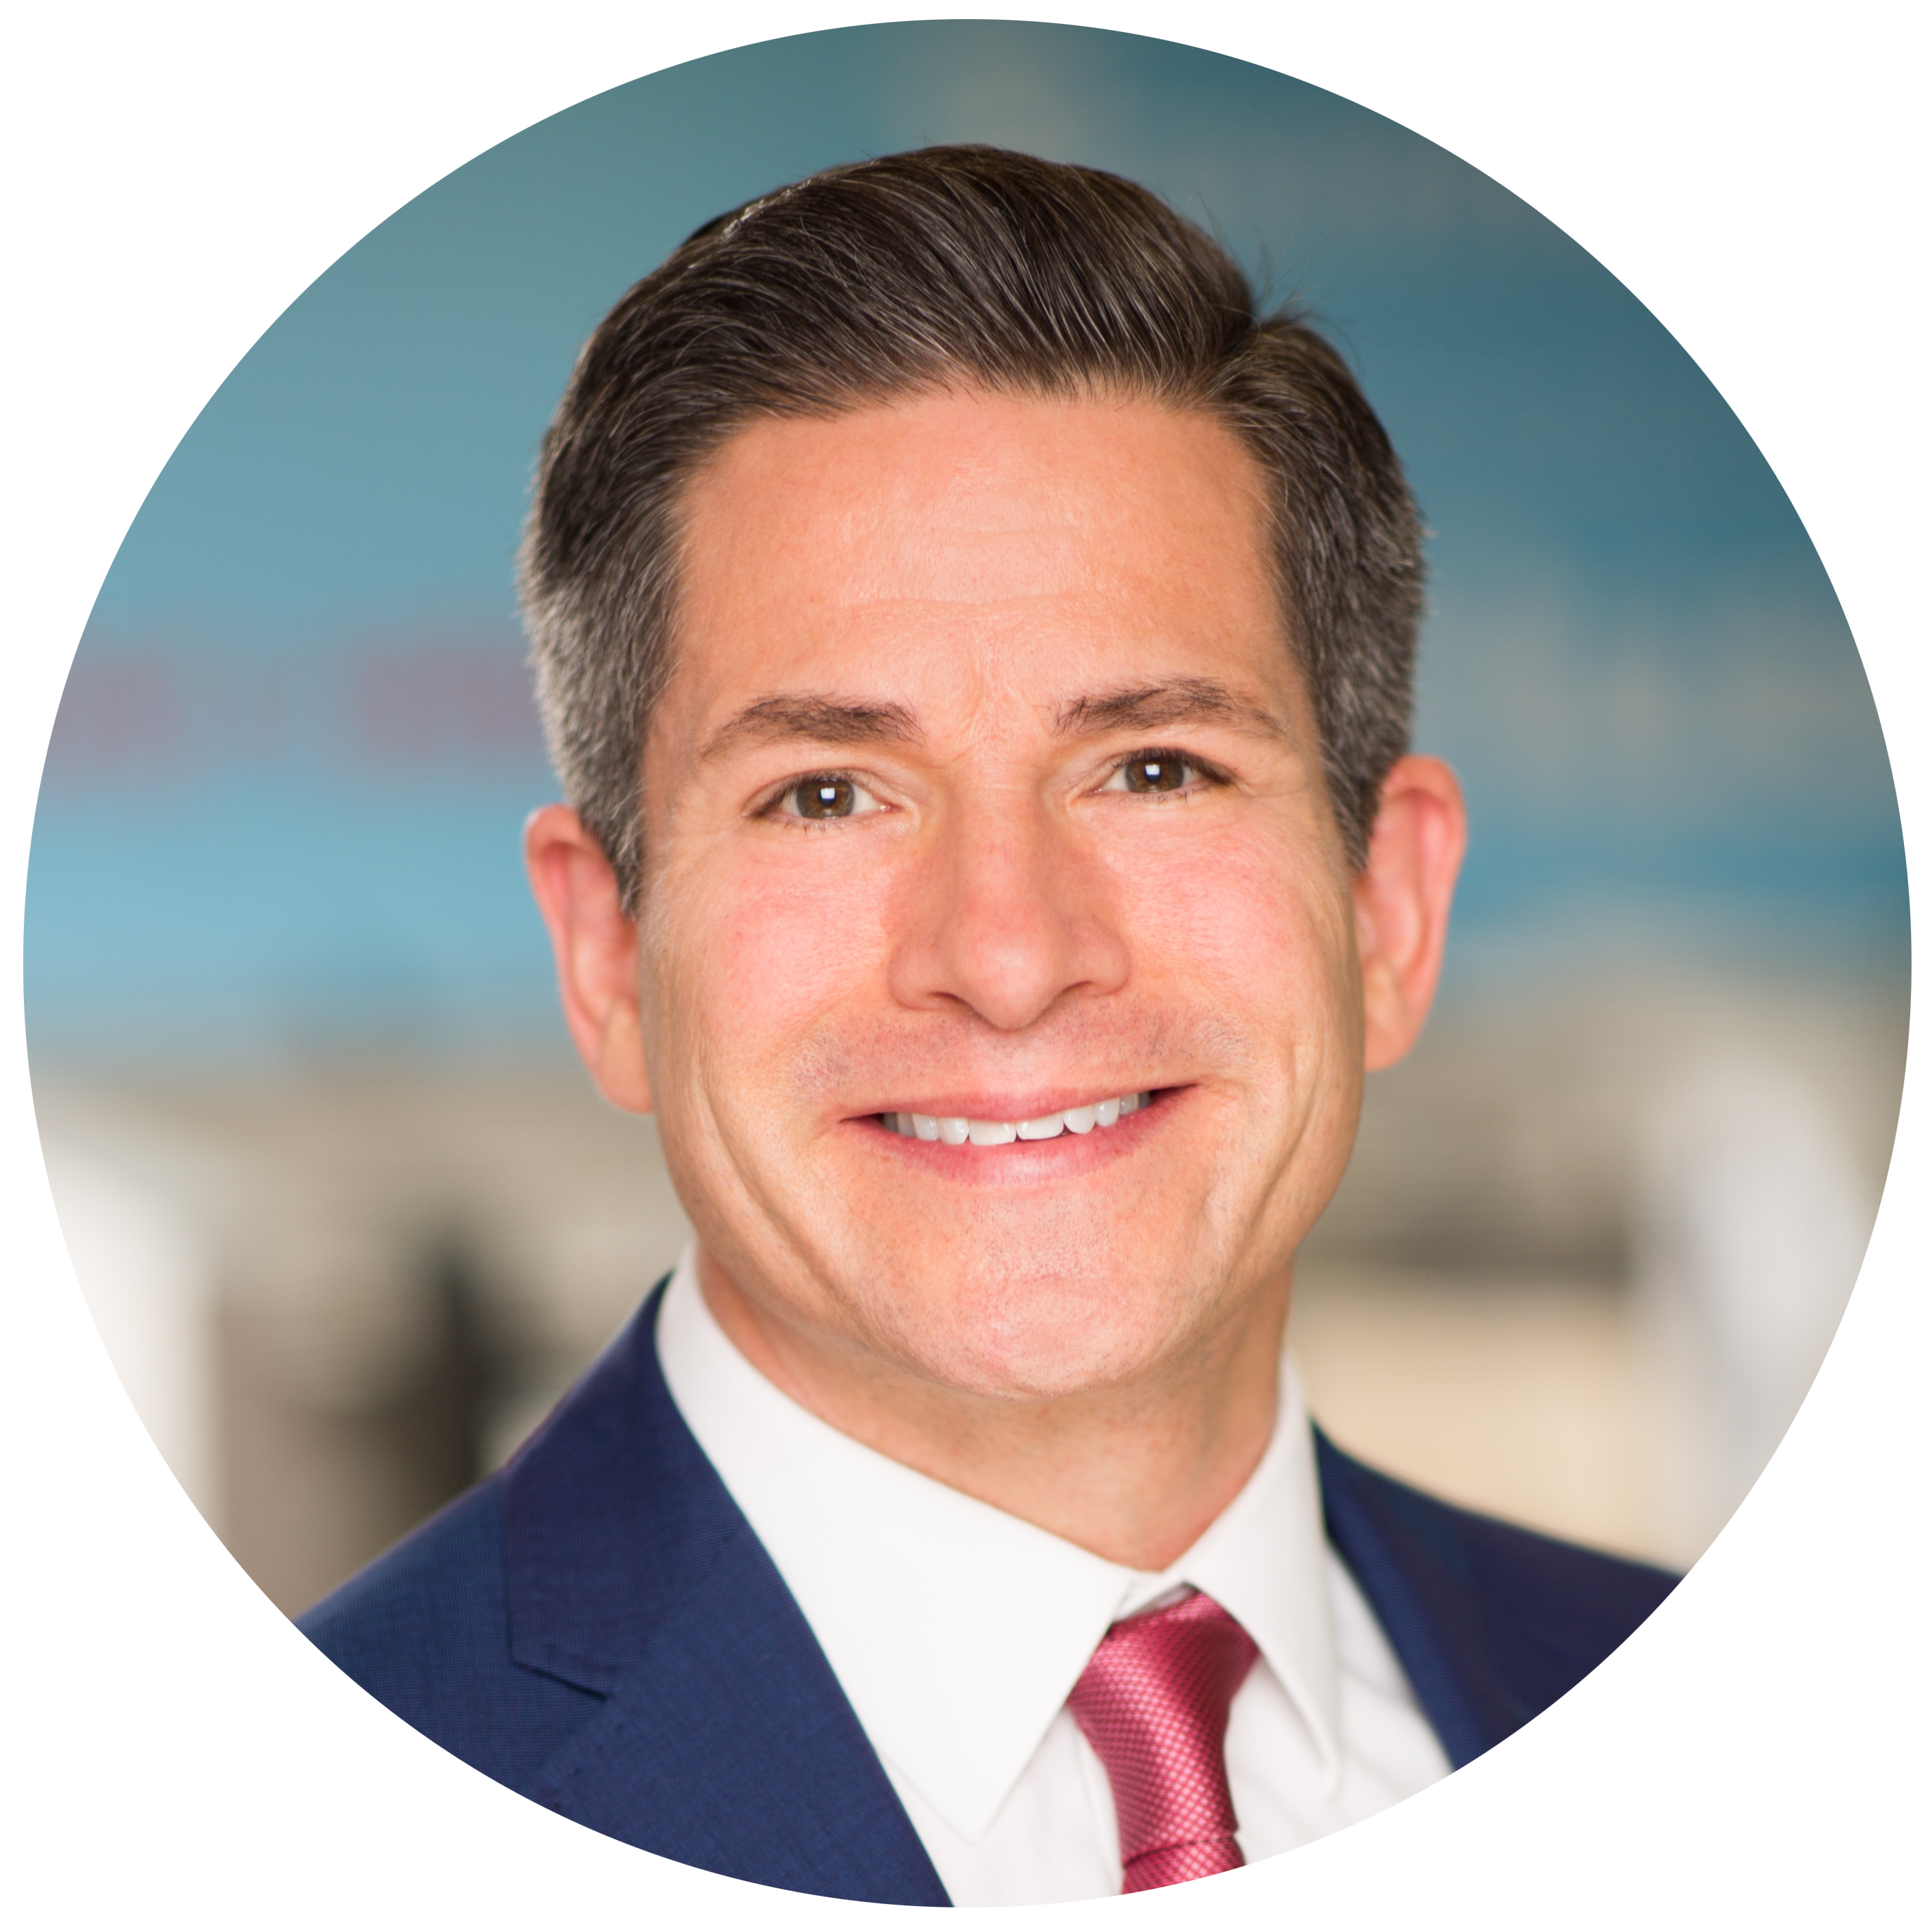
CASSIE CARTER, PH.D
DAN NEVEZ
Vice President & West Region Director Campbell & Company
she/her
Vice President, Executive Search Campbell & Company
he/him/él

Slide 4
Giving USA Data:
What did philanthropy look like in 2021?

Slide 5
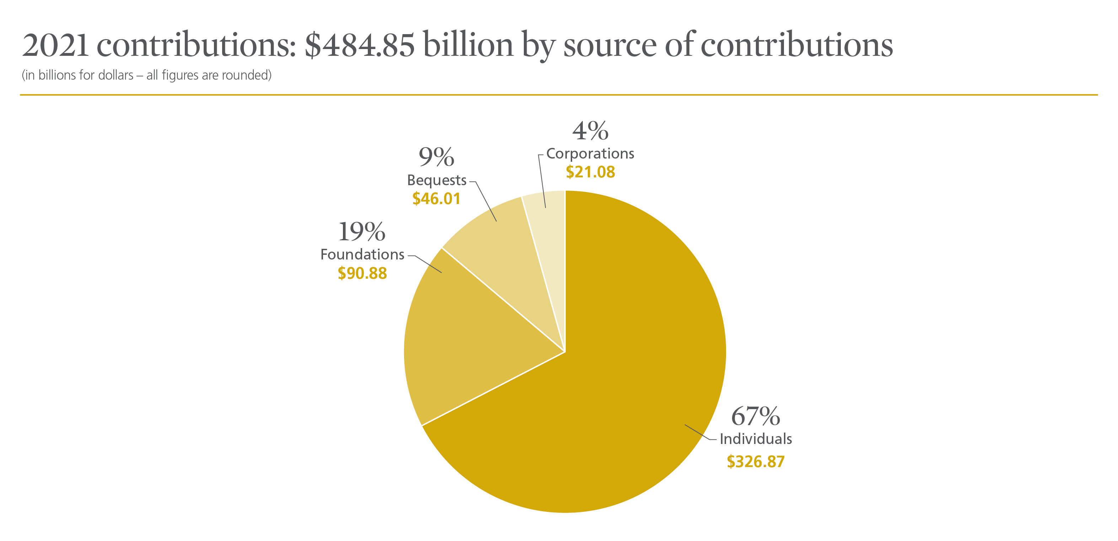
Notes:
Giving by individuals comprised 67 percent of total giving in 2021.¹
• Giving by foundations—which includes grants made by independent, community, and operating foundations—amounted to 19 percent of all gifts made in 2021. ²
• Giving by bequest accounted for 9 percent of all gifts made in 2021.
• Giving by corporations comprised 4 percent of total giving in 2021.

Slide 6
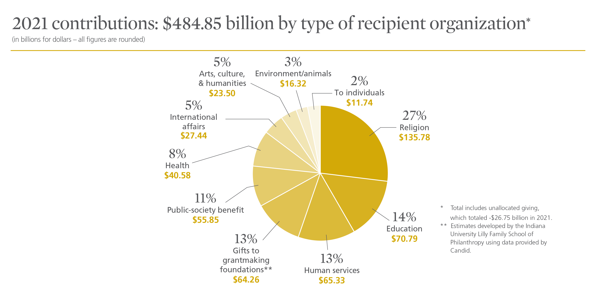
Notes:
Religious organizations received the largest share of charitable dollars in 2021, at 27 percent of total giving. ³
The education subsector comprised the second-largest portion of charitable dollars in 2021, receiving 14 percent of total gifts.
Human services organizations ranked third in total gifts received, at 13 percent of charitable dollars in 2021.
Gifts to grantmaking foundations—including independent, community, and operating foundations—comprised the fourth-largest share of charitable dollars in 2021, amounting to 13 percent of total giving.
Comprising the fifth-largest portion of charitable dollars in 2021, public-society benefit organizations received 11 percent of total giving.
The health subsector ranked sixth in total gifts received, at 8 percent of charitable dollars in 2021.
The international affairs subsector ranked seventh in total gifts received, amounting to 5 percent of charitable dollars in 2021.
Arts, culture, and humanities organizations received the eighth-largest portion of charitable dollars in 2021, at 5 percent of total giving.
Comprising the ninth-largest share of charitable dollars in 2021, the environment and animals subsector received 3 percent of total gifts.
Finally, gifts made directly to individuals amounted to 2 percent of total giving in 2021.

Slide 7
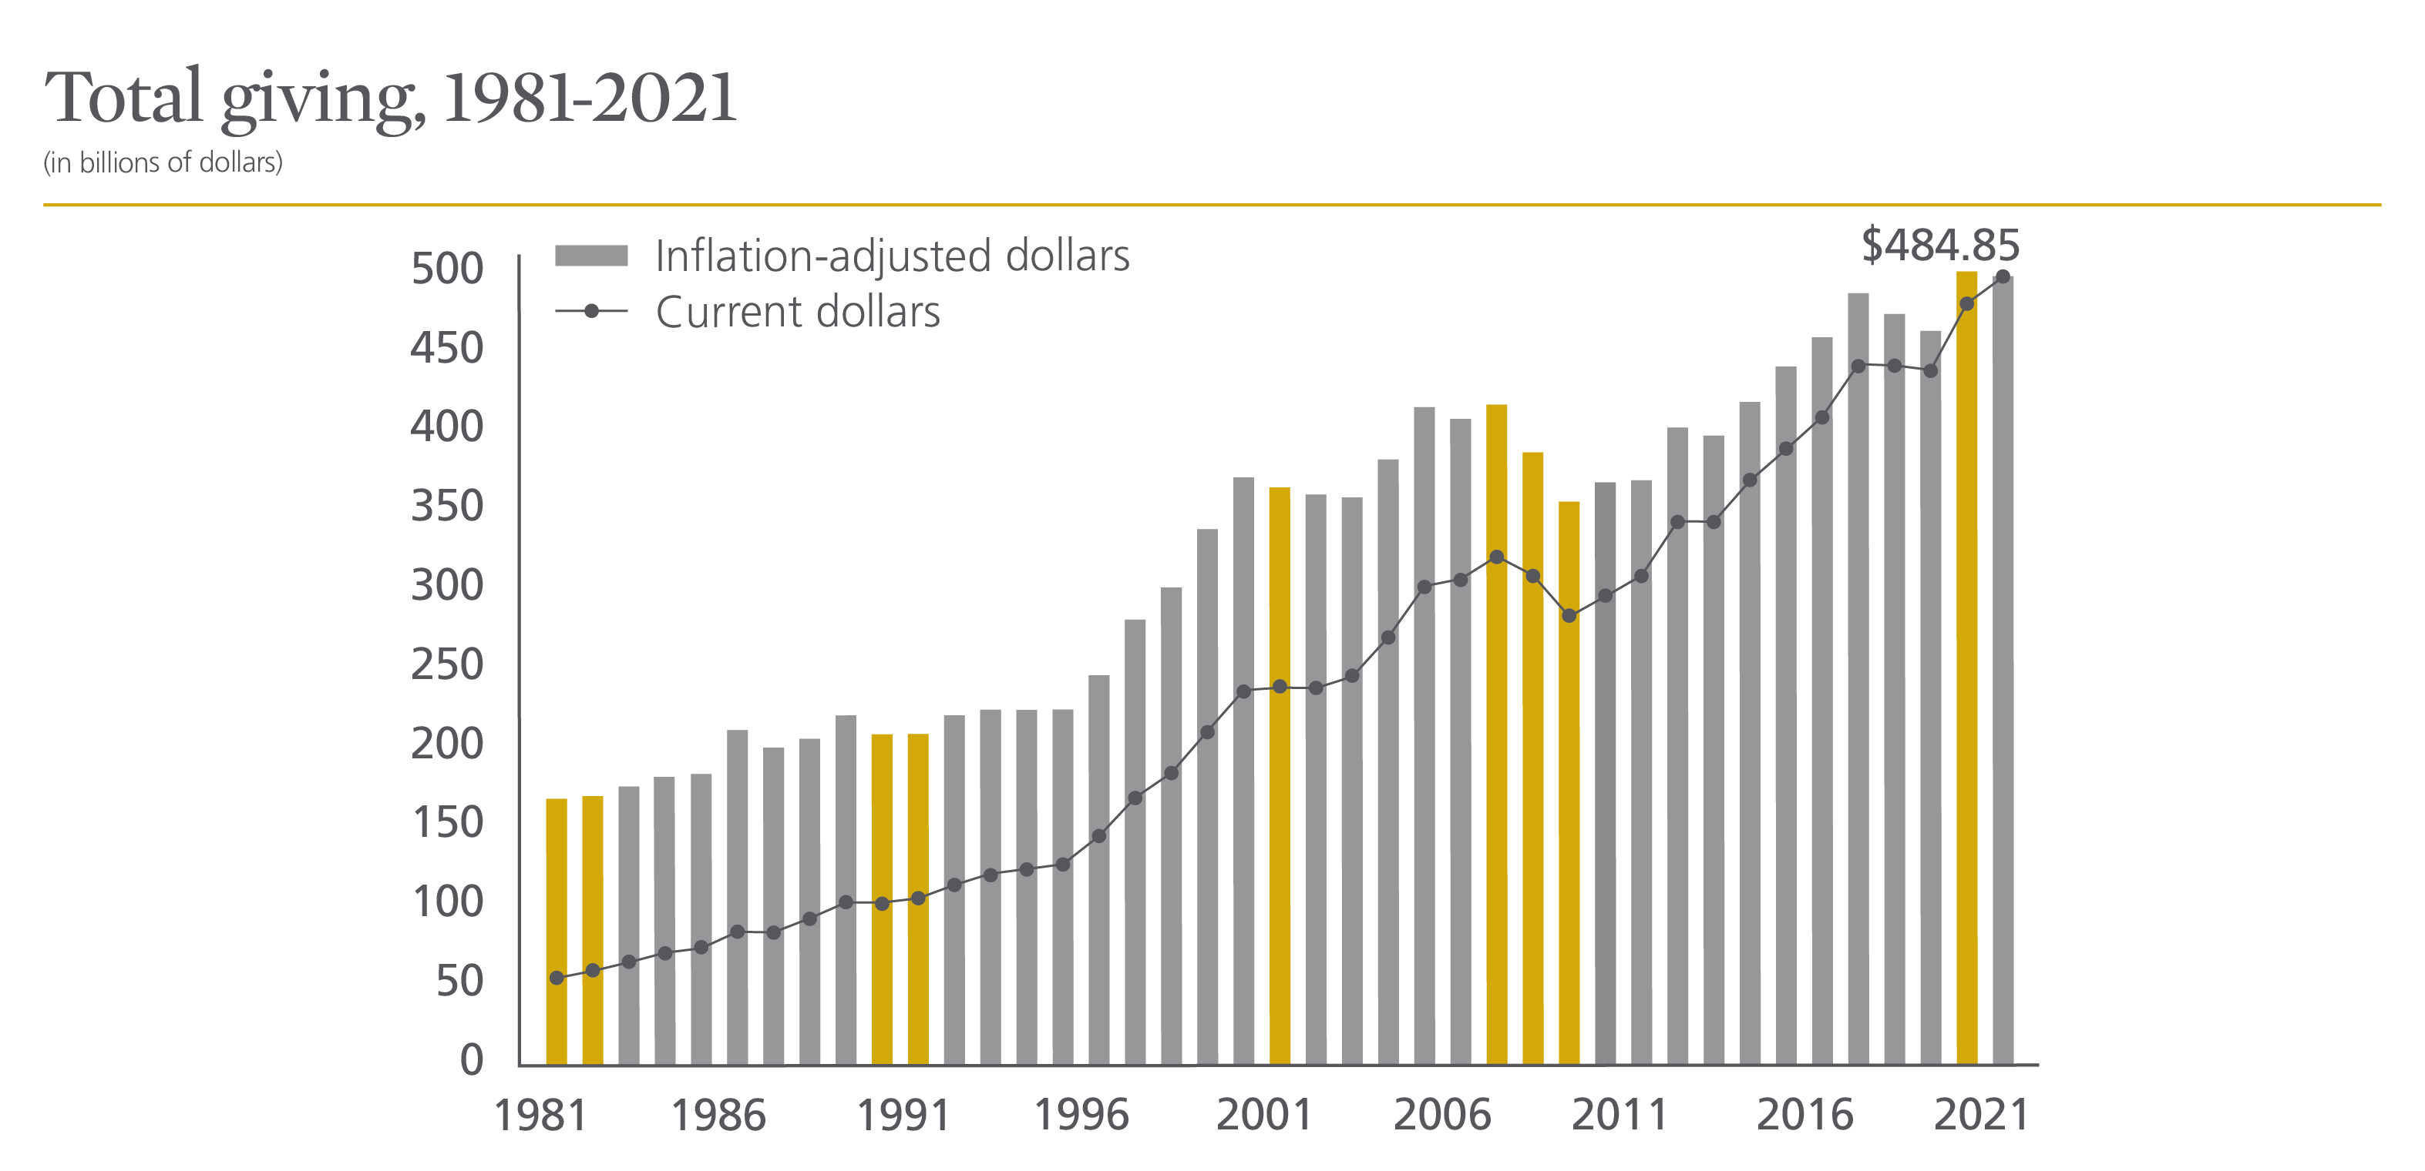
Notes:
Total giving reached $484.85 billion in 2021, a 4.0 percent increase in current dollars. In inflation-adjusted terms, total giving changed by -0.7 percent in 2021, staying relatively flat with 2020. ¹⁰
Total charitable giving has increased or stayed flat in current dollars every year since 1981, with the exception of three years that saw declines: 1987, 2008, and 2009. ¹¹ The annualized average rate of change in total giving in current dollars since 1981 is 5.6 percent. By comparison, the rate of change between 2020 and 2021 is lower than the 40-year annualized average.
Adjusted for inflation, total charitable giving has declined ten times since 1981. The average annualized rate of change in total giving in inflation-adjusted dollars since 1981 is 2.7 percent, making the inflation-adjusted rate of change between 2020 and 2021 lower than average.
The Great Recession ended in 2009. For the most recent decade from 2012 to 2021, the total growth in inflation-adjusted giving is 24 percent.
In 2021, none of the four giving sources reached an all-time high in inflation-adjusted terms, but individuals, foundations, and bequests reached the second highest levels of giving on record. On the recipient side of giving, four charitable subsectors exceeded their previous highs in inflation-adjusted terms.

Slide 8
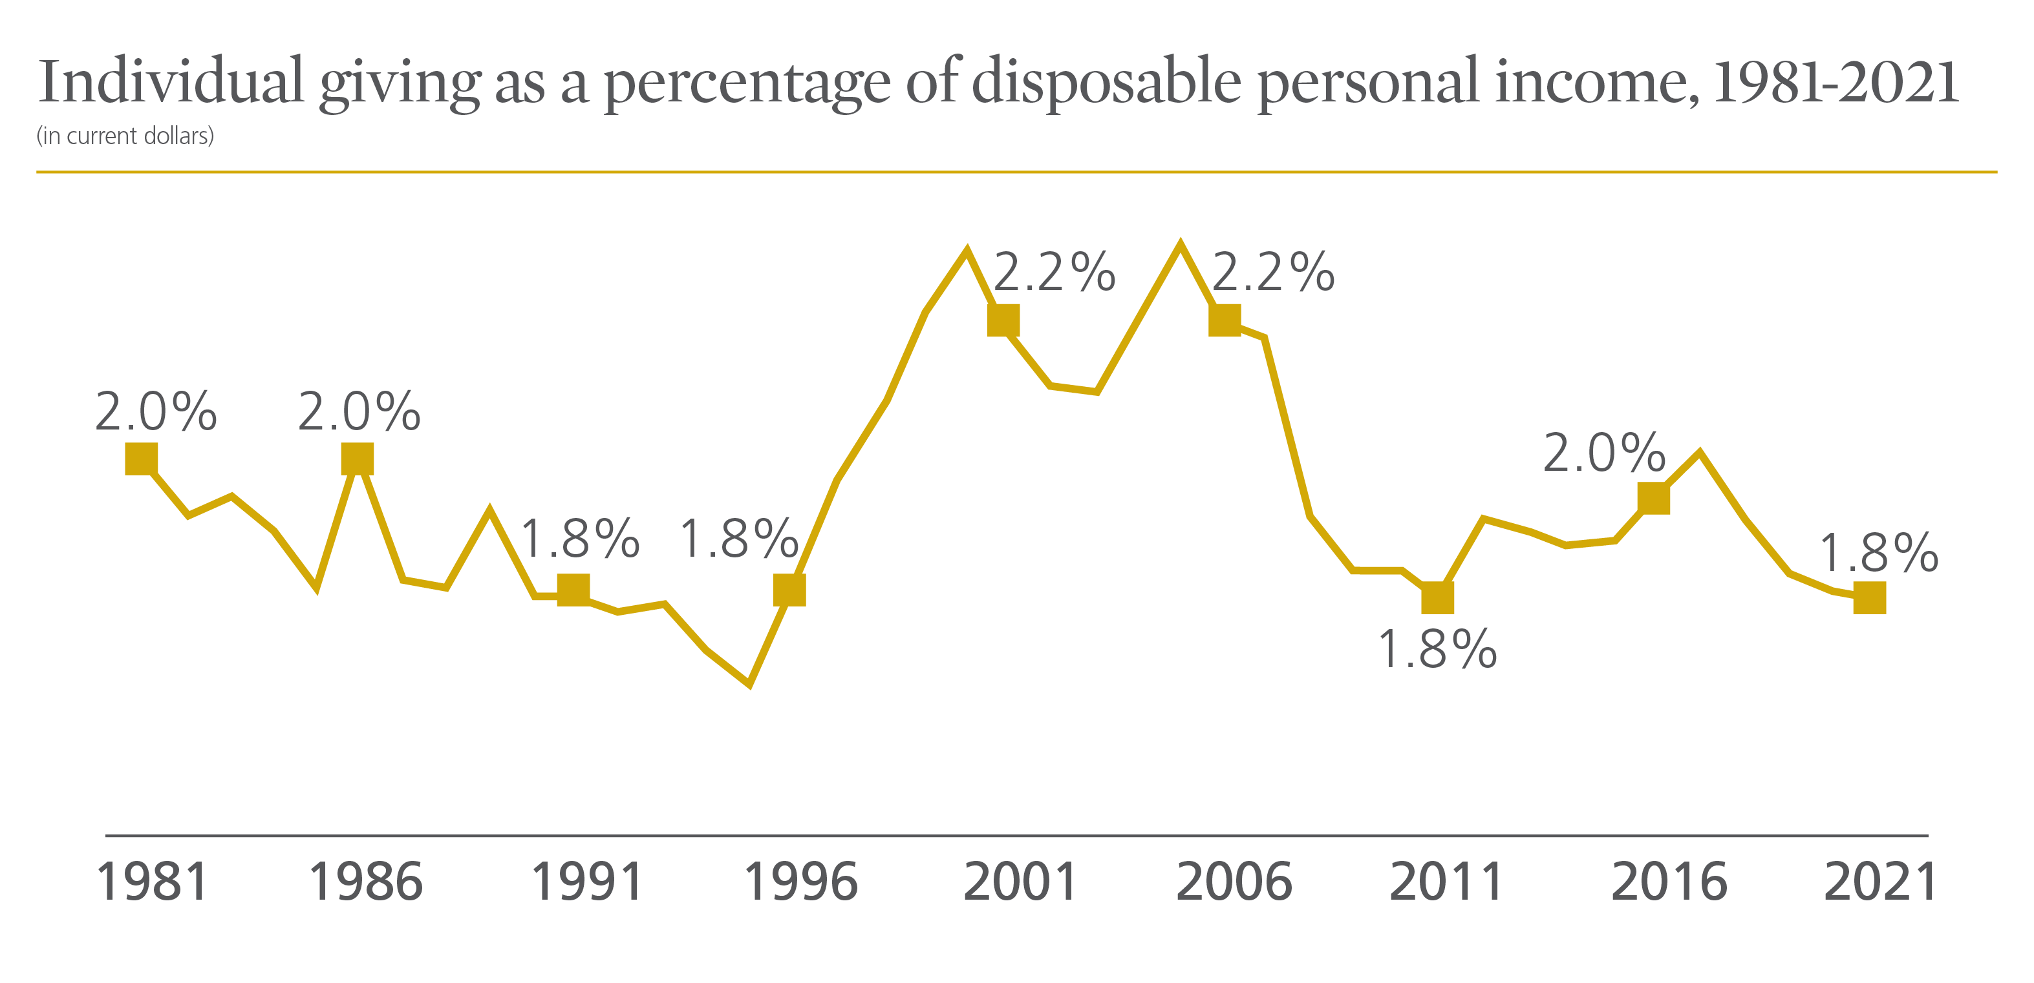
Notes:
Disposable personal income is tied to total household income, which is a key determinant of how much households give. In many cases, how much households give depends on their spendable, or disposable personal, income. This type of income is defined as that which is available after taxes have been paid. ²⁷
In 2021, disposable personal income increased 6.1 percent in current dollars from 2020, or 1.3 percent adjusted for inflation. This compares with 4.9 percent growth in individual giving between 2020 and 2021, or flat growth of 0.2 percent adjusted for inflation. ²⁸
In current dollars, individual giving as a percentage of disposable personal income was 1.8 percent in 2021—staying level with 2020.
During the last 40 years, individual giving as a percentage of disposable personal income reached its highest level in 2005, at 2.4 percent. Individual giving as a percentage of disposable personal income reached its lowest level in 1995, dropping to 1.7 percent.

Slide 9
Characteristics Shared by Nonprofits with High Performing Major Gift Programs

Slide 10
METHODOLOGY: FOCUS ON NONPROFIT MAJOR GIFT FUNDRAISING TRENDS
NONPROFIT SURVEYS
Two online surveys
120+ nonprofits
INDEPTH CASE STUDIES
Interviews with development leaders and case studies representing a variety of sectors and organizational sizes
DATA ANALYSIS
Data analyzed and compared to Giving USA data and post 2008 recession giving data

Slide 11
OVERVIEW OF TRENDS
The number of organizations raising more than $2.5 million in major gifts continues to increase significantly (23% in the past three years)
The gifts are large - almost two-thirds of nonprofits surveyed received at least one gift of $1 million or more in the last three years
z
The number of organizations focusing on major gifts continues to increase - 70% of nonprofits surveyed raise $1 million + in major gifts

Slide 12
A FOCUS ON MAJOR GIFTS MAKES AN IMPACT
Having even one full-time major gift fundraiser increased the number of $10,000 or more gifts received by 54.5%
Organizations with five or more full-time major gift fundraisers receive at least 25 major gifts, and 57% of these organizations received more than 75 gifts of over $10,000
z
Organizations that received 4 or more gifts of at least $1 million in the last three years have at least two full-time major gift fundraisers

Slide 13
HIGH PERFORMING ORGANIZATIONS SHARE THESE ELEMENTS
THE CASE
LEADERSHIP
Clear, compelling, simple, mission focused funding priorities
Funding priorities need to be well understood by both staff and donors
Staff and Board members are involved in fundraising on a regular basis
Both can speak to the case for support from a personal perspective

Slide 14
HIGH PERFORMING ORGANIZATIONS SHARE THESE ELEMENTS
DONOR ENGAGEMENT
SYSTEMS
Donor strategies are donor-centered and data-driven.
Deliberate engagement with clear documented relationship management within the organization
Data is utilized to prioritize donor engagement, guide activity, and drive momentum.
If it doesn’t represent strategy and if you can’t track it in consistent reports – don’t waste time collecting it

Slide 15
MOST IMPORTANTLY – HIGH PERFORMING ORGS SHARE:
Staff that have time dedicated to engagement with major gift level donors
Major gift focused staff have little to no administrative responsibilities
They work in a culture that encourages/insists that they interact directly with donors
They have access to key leadership

Slide 16
PLANNING AND LEADERSHIP INVOLVEMENT: HIGH PERFORMING ORGANIZATIONS SHARE THESE ELEMENTS
92% have a development plan that focuses on raising major gifts, even though 18% of these organizations don’t have any full-time major gift fundraisers
In 90% of organizations surveyed, the Board of Directors is involved in major gift cultivation and solicitation
Campaigns are a fabulous organizing construct. The majority of orgs are currently engaged in a campaign (52%) or looking to begin a campaign in the next 3 years (51%)
In 96% of organizations surveyed, the head of the organization is involved

Slide 17
HIGH PERFORMING ORGANIZATIONS SHARE THESE ELEMENTS
METRICS
SYSTEMS
Substantive donor interactions
Monthly or Quarterly that equate to roughly 100+ interactions annually
Clear roles and process
Segment by capacity and “readiness” to give
RM who is responsible for strategy
Right people identified to meet regularly as a fundraising team

Slide 18
MAJOR GIFT STRUCTURE AND RESOURCES: DATA DRIVEN STRUCTURE WILL HELP FOCUS EFFORTS
The use of data and metrics to inform fundraising efforts was a consistent theme across organizations. Select reasons organizations cited for increased fundraising success:
“We started using DonorSearch.”
“Better focus on development efforts.”
“Implemented a better donor database.”
“Renewed attention to fundraiser work plans and metrics.”
“Try to create hot, warm, cold list to place portfolios.”

Slide 19
STRATEGIC, DELIBERATE DONOR ENGAGEMENT: PORTFOLIO SIZE AND STRUCTURE IS IMPORTANT
Trends show that for every 100 prospects, only one-third of those prospects will be in the solicitation phase of the pipeline at any given time.
All 100 prospects need regular stewardship. Distribution and size of portfolios should take this into account.
Smaller organizations need to build balanced portfolios with prospects at each stage in the donor cycle to ensure that all donors and prospects have someone paying appropriate attention to them.
z
Organizations that received four or more gifts of at least $1 million in the last three years have at least two full-time major gift fundraisers.
z

Slide 20
STRATEGIC, DELIBERATE DONOR ENGAGEMENT
What is the ideal number of prospects to have under management?
What is the ideal portfolio size?
Industry standards are 100 to 200 prospects for a full-time frontline fundraiser with no administrative responsibilities
This may not be the right strategy – the numbers in isolation do not tell the story and often result in “padded” portfolios
As many as possible….
Nearly half of the organizations surveyed have less than 100 major gift prospects and donors currently under staff management

Slide 21
STRATEGIC, DELIBERATE DONOR ENGAGEMENT: QUALIFICATION
Cultivate
Solicit
A large number of prospects prioritized by capacity and engagement
Focus on moving them into other stages or removing them quickly
Focus on transitioning transactional annual donors into philanthropic major donors
Members & Annual Donors
Major Gift Donors
Mid-level Donors
Major Gift Prospects
Identify
Qualify
Requalify
Steward
Consider building portfolio numbers determined by donor stage and goals

Slide 22
STRATEGIC, DELIBERATE DONOR ENGAGEMENT: CULTIVATION & SOLICATION
Cultivate
Solicit
Part of the same continuum – view them together
Structure by capacity and readiness
Use a two-level approach: donors ready to give soon, donors who need more time
Members & Annual Donors
Major Gift Donors
Mid-level Donors
Major Gift Prospects
Identify
Qualify
Requalify
Steward
Consider building portfolio numbers determined by donor stage and goals

Slide 23
STRATEGIC, DELIBERATE DONOR ENGAGEMENT: STEWARDSHIP
Cultivate
Solicit
Consider moving donors who are only in stewardship into a separate portfolio
Members & Annual Donors
Major Gift Donors
Mid-level Donors
Major Gift Prospects
Identify
Qualify
Requalify
Steward
Consider building portfolio numbers determined by donor stage and goals

Slide 24
STRATEGIC, DELIBERATE DONOR ENGAGEMENT
Consider utilizing “junior” MGOs.
Focus on your annual and transactional donors – transition to mid-level and major donors
Leverage this effort to serve as major gift qualification
Train staff to partner on hand-offs
Keep MGO portfolios focused on highest capacity prospects
And you need the right people out engaging your donors!

Slide 25
How To Hire and Keep a Major Gifts Team

Slide 26
TURNOVER IN THE DEVELOPMENT FIELD
16
MONTHS
$127,650
The average amount of time a fundraiser stays at his or her job
The direct and indirect costs of finding a replacement
Source: "The Cost of High Turnover in Fundraising Jobs," The Chronicle of Philanthropy, April 2, 2012. Based on research by Penelope Burk, President of Cygnus Applied Research.

Slide 27
TURNOVER IN THE DEVELOPMENT FIELD
“In the past two years, has your institution struggled to hire and retain frontline major gift fundraising officers?”
Yes 70%
No 28%
I don’t know 2%
Competition for experienced gift officers is fierce
These hiring/retention issues are bad for the nonprofit sector
70%
70% of respondents said they have struggled to hire and retain frontline major gift fundraising officers in the past two years
Source: Campbell & Company Alternative Fundraising Talent research study

Slide 28
ASSESSING TALENT: OUTLINE OF INITIAL CONVERSATION TO MEASURE AND QUANTIFY PERFORMANCE SKILLS
Mission alignment (very important, passion = 110% effort)
Evidence of growth as high performer (i.e., track record of fundraising)
Make more visits
Secure new donors and prospects
Secure and close gifts “faster”
Secure high yield gifts
Set higher standards for professional excellence (exceeds goals) rather than specific amount
Pattern of increasing complexity of work
Soft skills: listening, resilience, self-starting, driven, eager to learn

Slide 29
SAMPLE INTERVIEW QUESTIONS
”
”
Always be consistent in asking your core questions:
“What’s your interest in our mission? Why did you choose a career in fundraising?”
“Why did you lose your last job? What would you manager say was the reason?”
“What do you consider your most successful role in fundraising and why?”
“What did you raise in 2022? 2021? 2020?”
“What was your most complex gift and why?”

Slide 30
AVOID UNCONSCIOUS BIAS
”
”
Also, beware of unconscious bias:
Gut feelings
“Younger me”
Gender, race, ethnicity
Personal style
Communication style
Weight and height

Slide 31
Alternative Fundraising Talent

Slide 32
A SCARCITY OF “QUALIFIED” CANDIDATES IS THE MOST-OFTEN CITED REASON FOR HIRING CHALLENGES
88%
Large campaigns require large teams
Qualified talent is not cheap
So what does ‘qualified’ mean?
“Hiring challenges are due to
(select all that apply):”
Lack of qualified candidates 88%
Geography of our institution 51%
Not able to agree on compensation 44%
Other 16%
Of those who had experienced hiring challenges, 88% said it was due to a lack of qualified candidates, with location and compensation also cited

Slide 33
THERE ARE A FEW COMMON CAREER SECTORS THAT PRODUCE MORE CANDIDATES MAKING THE SWITCH TO PHILANTHROPY
“Your most recent “non-traditional” hires have what types of professional backgrounds (select all that apply):”
Sales 68%
Marketing 57%
Financial Services 39%
Academic 29%
Political Campaigns 14%
Other 50%
For transitions into fundraising, some career paths are more natural than others:
Bankers
Wealth Managers & Financial Planners
Attorneys
Real Estate Brokers
Political Campaigners
Admissions Officers
64%
Our survey indicated more than 64% of respondents are intentionally recruiting non-traditional talent for direct fundraising positions

Slide 34
Retaining
Fundraising Talent

Slide 35
HAVE CLEAR ROLE DESCRIPTIONS AND ACHIEVABLE GOALS
Provide MGOs metrics to achieve and reward those goals
Clearly describe roles and set reasonable expectations
Create ambitious but achievable goals
Implement a formal review process

Slide 36
CONTINUOUS LEARNING ENSURES GREATER LOYALTY AND RETENTION
Assess their skillset
Chart the job they want
Know their commitment to learning will be rewarded
Identify gaps and fill them

Slide 37
ARE YOU PAYING ENOUGH? TALK TO YOUR LEADERSHIP
Example: Market Salaries for MGOs in Los Angeles
Small colleges: $65K - $125K
Large flagship universities: $120K - $215K
Healthcare institutions: $135K - $240K
Small/medium nonprofits: $70K - $160K
Top Tier MGOs: $170K - $210K
Workplace flexibility and
family leave
Be flexible on potential benefits
Family-friendly policies retain valuable employees who need help balancing work and family
Research shows that access to any form of parental leave builds loyalty to the organization…they stay

Slide 38
PERFORMANCE-BASED INCENTIVES
Not “sales commission,” but based on pre-set mix of revenue and non-revenue goals
Growing number of incentive-based programs: around 18% CASE, 22% AFP, and 44% AHP
Types of performance incentives:
Annual incentives (94%), range from 5% to 30% of base salary
Recruitment incentives: signing bonus (42%)
Multiyear incentives (21%), act as retention incentive

Slide 39
KPIs FOR PERFORMANCE-BASED INCENTIVES
NONREVENUE CATEGORIES | PERCENTAGE OF RESPONDENTS
Management/leadership | 54%
Total gifts secured | 54%
Number of proposals/solicitations made | 33%
Stewardship | 31%
Visits/contacts | 31%
Prospect solicitation | 29%
Donor retention | 25%
Other | 21%
Close rate of proposals/solicitations | 19%
Professional development | 19%
New qualification visits | 17%
Prospect identification | 17%
Staff recruitment | 17%
Event attendance | 8%
Recognition | 8%
KEY REVENUE CATEGORIES:
75% New gifts (new business)
67% New pledges
23% Payments on prior year pledges
23% Other (not defined)

Slide 40
Wrapping It Together: Maximizing Your Fundraising ROI With Major Gifts

Slide 41
STRATEGIC, DELIBERATE DONOR ENGAGEMENT
Context
THE CASE - Clear, compelling, simple, mission-focused funding priorities that are well understood by both staff and donors
LEADERSHIP – Staff and Board members are involved in fundraising on a regular basis
DONOR ENGAGEMENT – Donor strategies are donor-centered and data-driven. Deliberate engagement with clear relationship management within the organization
SYSTEMS – Data is utilized to prioritize donor engagement, guide activity and drive momentum
If it doesn’t represent strategy and if you can’t track it consistently – don’t waste time collecting it
Staffing & Systems
Case for Support
FUNDRAISING
STRATEGY
Donor Engagement
Leadership

Slide 42
KEY TAKEAWAYS
Major gifts are increasing, including gifts at the $1M+ level and greater
Make major gifts an organization-wide priority: include board, CEO, and staff, and invest in staffing and systems. Give MGO's a clear "runway" to focus on donor engagement
z
Data management is critical: track and manage donor relationships in your database with key metrics for measuring success. Less is more

Slide 43
KEY TAKEAWAYS
Strive to maintain strategic portfolios to allow more intentional cultivation and stewardship. Don’t fall into the trap that one size fits all
Always keep an eye out for emerging talent! Build your network through AFP and LinkedIn. Assess major gifts talent through a uniform criteria for measuring growth and performance
z
Keep talent through a strong base salary, clear achievable goals, workplace flexibility, and performance incentives based on mix of revenue and non-revenue goals

Slide 44
We can be reached here!
Thank you!
Cassie Carter, Vice President
cassie.carter@campbellcompany.com
Dan Nevez, Vice President
dan.nevez@campbellcompany.com

